Slide 1


Case #8
Daily CSI
Can you solve it?
Missing Masterpiece
8th Grade Forensic Science
T. Trimpe 2006 http://sciencespot.net/

Slide 2
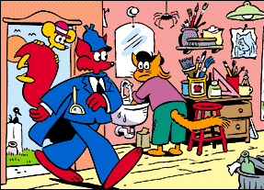
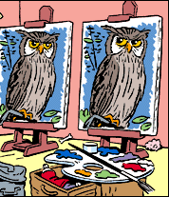
A painting by a world-renowned artist was stolen from the Forest Museum. The missing masterpiece is now in Kopy Kat's studio. The feline forger has already painted a copy of the artwork. Which one does Slylock Fox suspect is the original painting?
Hint: What is different about the owls?
Source: http://www.slylockfox.com/arcade/BrainBogglers/index.html

Slide 3
Solution
An owl cannot move its eyes from side to side,
but must turn its head to see in other directions.
The painting with the eyes pointed straight ahead is the original.

